Slide 1

Loan Risk Data Pipeline (Bronze → Silver → Gold)
CS611 Assignment 1: Data Processing Pipelines
Yip Pak Kei (01507599)
October 2026

Slide 2

Why Build This Pipeline?
Business Problem
Technical Objective
The bank issues cash loans.
Need to predict loan default risk at the point of application.
Why?
Reduce credit losses.
Support responsible lending.
Improve regulatory compliance.
Build a structured, reproducible and auditable data pipeline following medallion architecture.
Outputs:
Feature Store (Gold): model-ready features.
Label Store (Gold): default labels
Ensure:
Clean, consistent data
Scalable for future loan risk ML models
Traceable from raw to Model.

Slide 3






Architecture Overview
Data Quality
Datamart
ETL
Bronze
ETL
Silver
ETL
Gold
Loan Risk ML Model
Raw
Integration
Filtered, Cleaned, Augmented
Business-Level Aggregates
Raw Data from various data source
“Landing zone” for raw data, no schema needed.
Define structure, enforce schema, evolve as needed.
Deliver continuously updated, clean data to downstream users and apps.

Slide 4









Raw Data to Bronze
Attributes
Bronze
Clickstream
ETL
Extract: Loans, Clickstream, Financials
Transform: Keep minimal and just filtering by snapshot date.
Load: Stored as partitioned CSVs by snapshot dates.
Jan Feb Mar Dec
Financials
Attributes
Loans
Financials
Raw Data
Design Rationales
Different data sources:
Clickstream - User’s historical usage behavior on our bank’s app.
Attributes - User’s profile.
Financials - Users’ financials profile.
Loans – Users’ loan records (target label table).
Keep data untouched for audit trail.
Partition by snapshot month for reproducibility.
Clickstream
Confidentiality
The bronze datamart is classified as “Confidential” since Personal Identifiable Information (PII) information such as Name and SSN are stored in it.

Slide 5

Bronze TO Silver(Features)
ETL
Extract: Bronze clickstream, attributes and financials.
Transform:
Enforce schema on all features.
Attributes: Mask PII and set invalid Age range.
Clickstream: Convert 20 features (fe_1 to fe_20) to integers.
Financials: Parse numeric fields, cleans invalids, standardize “Type_of_Loan” and “Credit_History_Age” and split payment behaviour.
Load: Stored as cleaned, standardized and partitioned Parquet files by snapshot dates.
Bronze
Silver
Jan Dec
Jan Dec
Attributes
Attributes
Financials
Financials
Clickstream
Design Rationales
Clickstream
The PII are masked in the silver layer to ensure sensitive information would not be accidentally shared within the enterprise.
Schema enforcement prevents dirty data from propagating.
Separate logic per data domain ensures data quality early.
Partition by snapshot month for reproducibility.
Silver Layer
“Enterprise view” of all business entities.
"just-enough" transformations and data cleansing of the data from the bronze layer.
Data schema enforcement.

Slide 6


Bronze TO Silver(LOANs)
ETL
Extract: Load Bronze loans.
Transform:
Enforce schema on all loans features.
Add derived fields:
MOB = Month on Book.
DPD = Days Past Due (30 days).
Installments Missed (Derive DPD)
First Missed Day (Derive DPD)
Load: Stored as cleaned, standardized and partitioned Parquet files by snapshot dates.
Silver
Jan Dec
Bronze
Loans
Jan Dec
Silver Layer
“Enterprise view” of all business entities.
"just-enough" transformations and data cleansing of the data from the bronze layer.
Data schema enforcement.
Loans
Design Rationales
Schema enforcement prevents dirty data from propagating.
Derive additional fields for next stage exploratory data analysis to determinate the target label in Gold layer.
Partition by snapshot month for reproducibility auditability.

Slide 7
Silver TO Gold(Features)
ETL
Extract: Bronze clickstream, attributes and financials.
Transform:
Enforce schema on all features.
Attributes: Mask PII and set invalid Age range.
Clickstream: Convert 20 features (fe_1 to fe_20) to integers.
Financials: Parse numeric fields, cleans invalids, standardize “Type_of_Loan” and “Credit_History_Age” and split payment behaviour.
Load: Stored as cleaned, standardized and partitioned Parquet files by snapshot dates.
Silver
Silver
Jan Dec
Jan Dec
Attributes
Attributes
Financials
Financials
Clickstream
Design Rationales
Clickstream
The PII are masked in the silver layer to ensure sensitive information would not be accidentally shared within the enterprise.
Schema enforcement prevents dirty data from propagating.
Separate logic per data domain ensures data quality early.
Partition by snapshot month for reproducibility.
Silver Layer
“Enterprise view” of all business entities.
"just-enough" transformations and data cleansing of the data from the bronze layer.
Data schema enforcement.

Slide 8




Silver To Gold(LOANs)
Silver
ETL
Extract: Load Bronze loans.
Transform:
Define label = 1 if loan is ≥ 30 days (DPD) past due at 6 months (determined from EDA) on book.
Loan ID, Customer ID and loans snapshot date are kept.
Load:
Stored as partitioned Parquet files by label snapshot dates.
The data store is renamed to “label” data store.
Jan Dec
Gold
Loans
Jan Dec
Exploratory Data Analysis
Label
The bad rate trend by MOB are plotted:
Bad rate rise steeply from MOB 0-6 and stabilizes at 6.
Gold Layer
“Enterprise view” of all business entities.
"just-enough" transformations and data cleansing of the data from the bronze layer.
Data schema enforcement.
Design Rationales
Derive the target decision label for the next stage ML model training.
Centralized label definition ensures consistency across models.
IDs are kept for indexing, traceability, auditability.
Partition by snapshot month for reproducibility auditability.
Key Business Insights
Loan defaults mainly occur with the first 6 months after origination.

Slide 9
Extract: Bronze clickstream, attributes and financials.
Transform:
Enforce schema on all features.
Attributes:
Mask Personal Identifiable Information (PII) including Name and SSN.
Set invalid Age range to Null.
Clickstream:
Convert 20 features (fe_1 to fe_20) to integers.
Financials:
Parse Annual_Income, Num_of_Loan, Num_of_Delayed_Payment, Outstanding_Debt, Changed_Credit_Limit, Outstanding_Debt, Amount_invested_monthly, Monthly_Balance to numerical.
Clean “Type_of_Loan”
Parse “Credit_History_Age” to number of month.
Split Payment_Behaviour”
Load: Stored as standardized Parquet files.
The PII are masked in the silver layer to ensure sensitive information would not be accidentally shared within the enterprise.
Schema enforcement prevents dirty data from propagating.
Separate logic per data domain ensures data quality early.
Partition by snapshot month for reproducibility.
Design Rationales

Slide 10
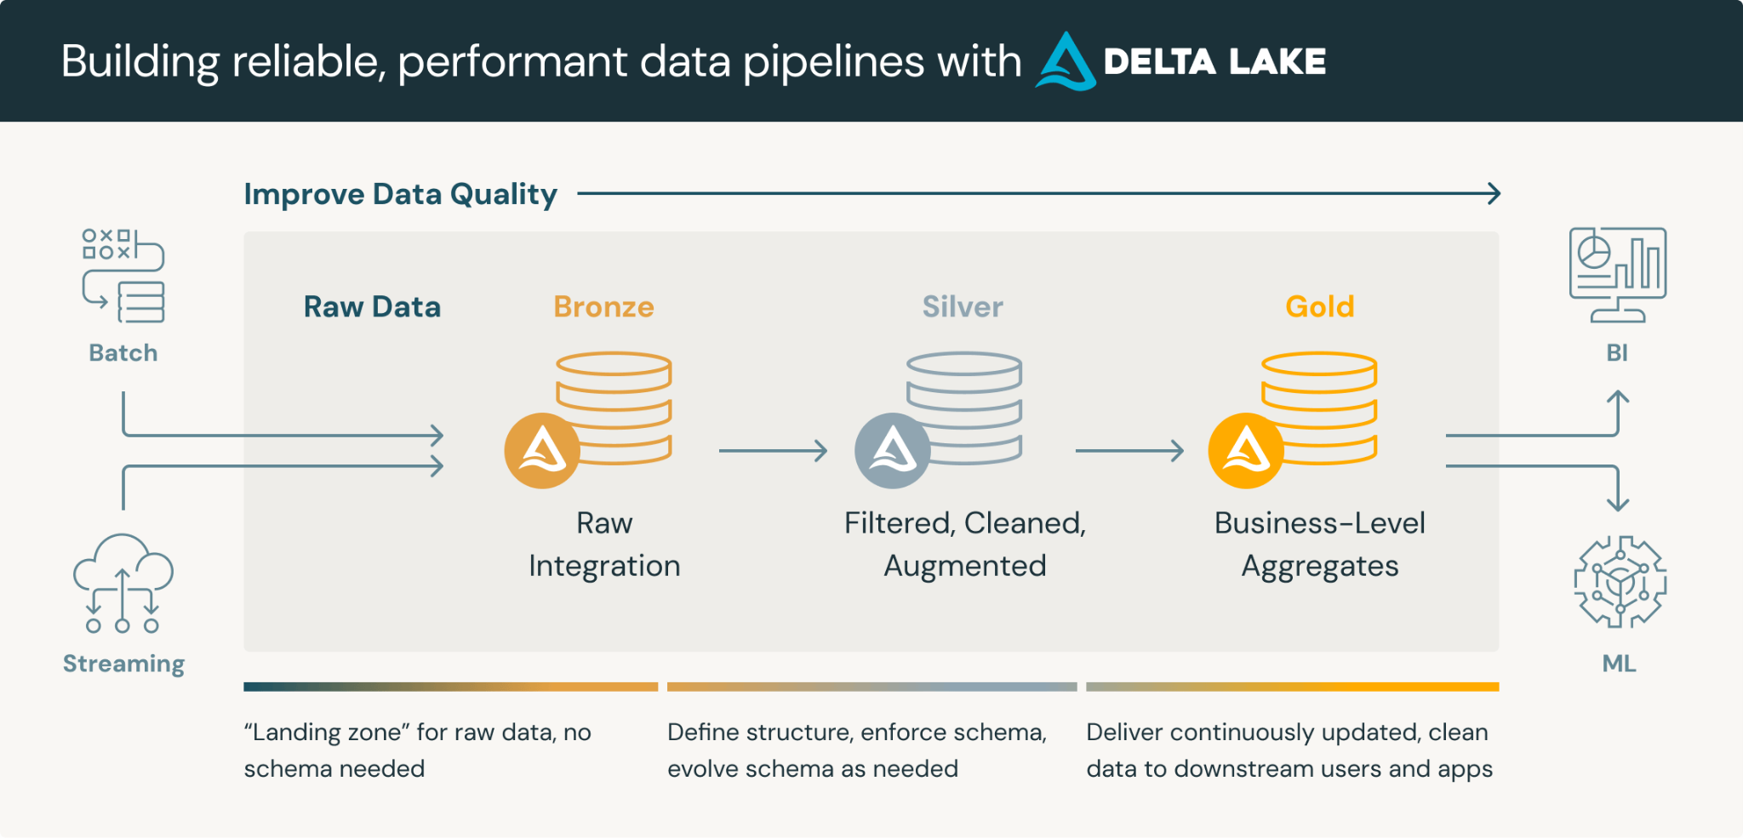





Architecture Overview
Step 1
Step 2
Step 3
Step 4
Step 5
Choose a cryptocurrency exchange
Purchase preferred coins & create "wallet"
Research investment and trading options
Stake preferred coins in chosen company
Set exponential growth goals

Slide 11
INTRODUCTION
At Krypto Logics, we empower investors to maximize their portfolios to help them meet their financial goals responsibly. By offering customized and sophisticated strategies, we help clients' portfolios grow organically and foster a trusted consumer-consultant relationship.

Slide 12
LONG-TERM VS. SHORT-TERM

Slide 13
GLOBAL CURRENCY MARKETS
 | $USD | £EUR | ¥JPY | ₿BTC
Q1 | 4.5 | 2.3 | 1.7 | 5.0
Q2 | 3.2 | 5.1 | 4.4 | 3.0
Q3 | 2.1 | 1.7 | 2.5 | 2.8
Q4 | 4.5 | 2.2 | 1.7 | 7.0

Slide 14
WEALTH IS THE ABILITY TO FULLY EXPERIENCE LIFE.
-Henry David Thoreau

Slide 15
TYPES OF TOKENS
Payment
Utility
Security
NFT
Gaming
Used to complete transactions anywhere crypto is accepted
These tokens have a specific use within a blockchain
Tokens backed by securities
Authenticates ownership of specific assets
Used as in-game currency and traded with real world value

Slide 16
AREAS OF FOCUS
Portfolio diversification
Short and long-term goals
Develop winning combinations to stay ahead of the market
Capitalize on direct ownership of digital coins
Invest in multiple blockchains​
Create an emergency fund
Add a second stream of income
Buy a house
Supplement retirement fund

Slide 17




MEET OUR TEAM
Takuma Hayashi​
Mirjam Nilsson​
Flora Berggren​
Rajesh Santoshi​
President
Chief Executive Officer
Chief Operations Officer
VP Marketing

Slide 18




MEET OUR EXTENDED TEAM
Takuma Hayashi​
Mirjam Nilsson​
Flora Berggren​
Rajesh Santoshi​
President
Chief Executive Officer
Chief Operations Officer
VP Marketing
Graham Barnes
Rowan Murphy
Elizabeth Moore
Robin Kline
VP Product
SEO Strategist
Product Designer
Content Developer

Slide 19
SUMMARY
At Krypto Logics, we believe in giving 110%. By using our next-generation data architecture, we help investors virtually manage their portfolios. We thrive because of our market knowledge and great team. As our CEO says, "Efficiencies will come from proactively transforming how we do business."

Slide 20
THANK YOU
Mirjam Nilsson​
mirjam@greatsiteaddress.com
www.greatsiteaddress.com

